Slide 1




STATISTICS ESSENTIALS
Accredited by IABAC™
© 2018 DataMites™. All Rights Reserved | www.datamites.com
STATISTICS ESSENTIALS

Slide 2

Overview of Statistics
Module - 1
© 2018 DataMites™. All Rights Reserved | www.datamites.com
STATISTICS ESSENTIALS

Slide 3
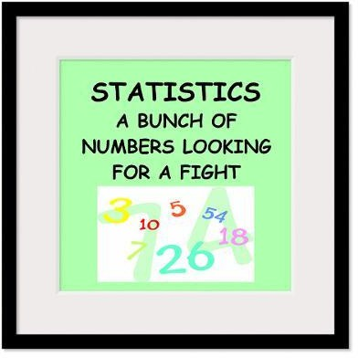
Statistics for Data
The science of collecting, describing, and interpreting data is popularly known as Statistical leveraging in Data Science.
Two areas of Statistics:
Descriptive statistics – Methods of organizing, summarizing, and presenting data in an informative way
Inferential statistics – The methods used to determine something about a population on the basis of a sample
© 2018 DataMites™. All Rights Reserved | www.datamites.com
STATISTICS ESSENTIALS

Slide 4

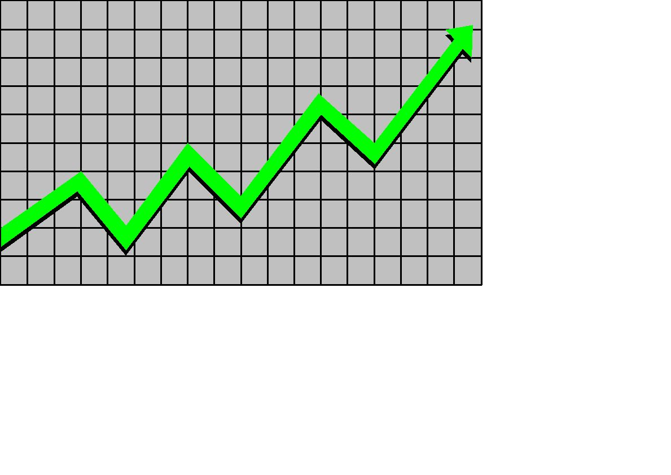
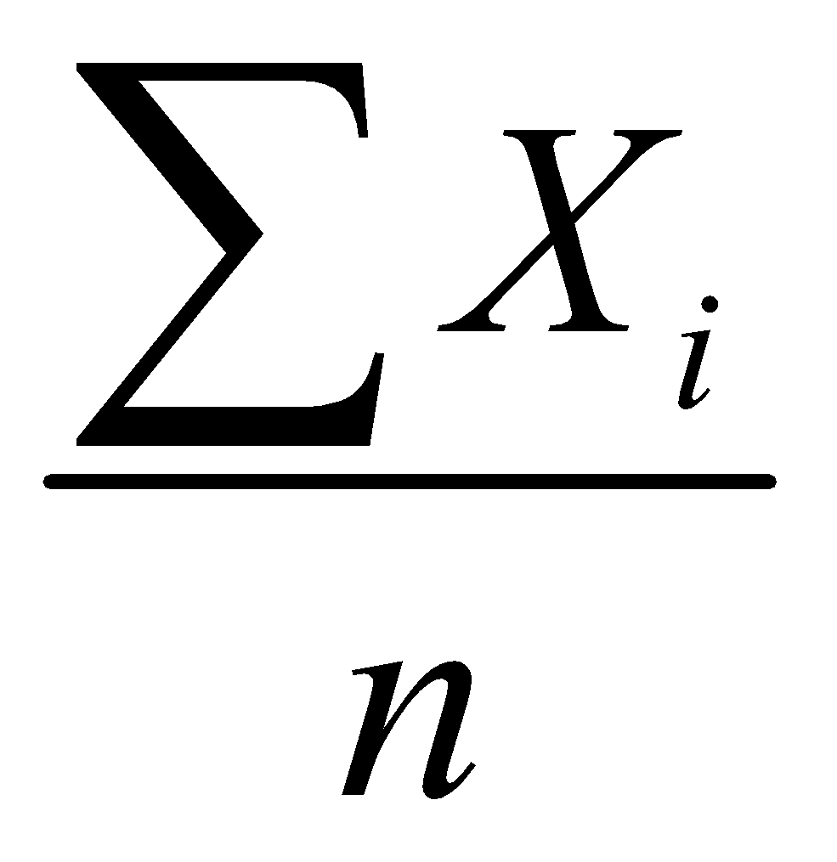
Descriptive Statistics
Descriptive statistics are methods for organizing and summarizing data.
For example, tables or graphs are used to organize data, and descriptive values such as the average score are used to summarize data.
A descriptive value for a population is called a parameter and a descriptive value for a sample is called a statistic.
Collect data
e.g., Survey
Present data
e.g., Tables and graphs
Summarize data
e.g., Sample mean =
© 2018 DataMites™. All Rights Reserved | www.datamites.com
STATISTICS ESSENTIALS

Slide 5
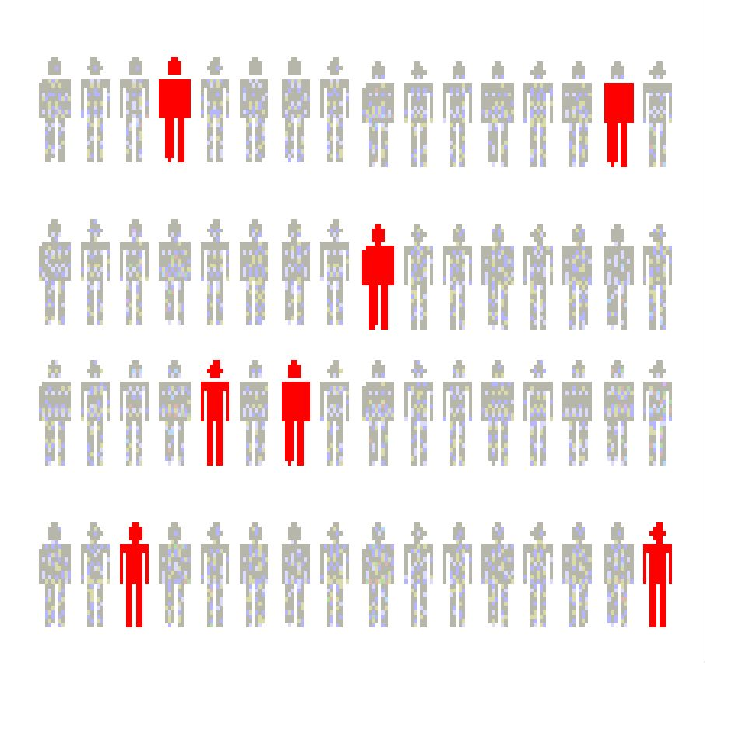
Inferential Statistics
Inferential statistics are methods for using sample data to make general conclusions (inferences) about populations.
Because a sample is typically only a part of the whole population, sample data provide only limited information about the population. As a result, sample statistics are generally imperfect representatives of the corresponding population parameters.
Estimation
– e.g., Estimate the population mean weight using the sample mean weight
Hypothesis testing
– e.g., Test the claim that the population mean weight is 70 kg
Inference is the process of drawing conclusions or making decisions about a population based on sample results
© 2018 DataMites™. All Rights Reserved | www.datamites.com
STATISTICS ESSENTIALS

Slide 6
Definition to Basic terms
Population: A collection, or set, of individuals or objects or events whose properties are to be analyzed.
Two kinds of populations: finite or infinite.
Sample: A subset of the population.
Variable: A characteristic about each individual element of a population or sample.
Data (singular): The value of the variable associated with one element of a population or sample. This value may be a number, a word, or a symbol.
© 2018 DataMites™. All Rights Reserved | www.datamites.com
STATISTICS ESSENTIALS

Slide 7
Definition to Basic terms
Data (plural): The set of values collected for the variable from each of the elements belonging to the sample.
Random Variable:Variable are placeholder where you can store anything.It can number,or string,sentences.
Experiment: A planned activity whose results yield a set of data.
Parameter: A numerical value summarizing all the data of an entire population.
Statistic: A numerical value summarizing the sample data.
© 2018 DataMites™. All Rights Reserved | www.datamites.com
STATISTICS ESSENTIALS

Slide 8
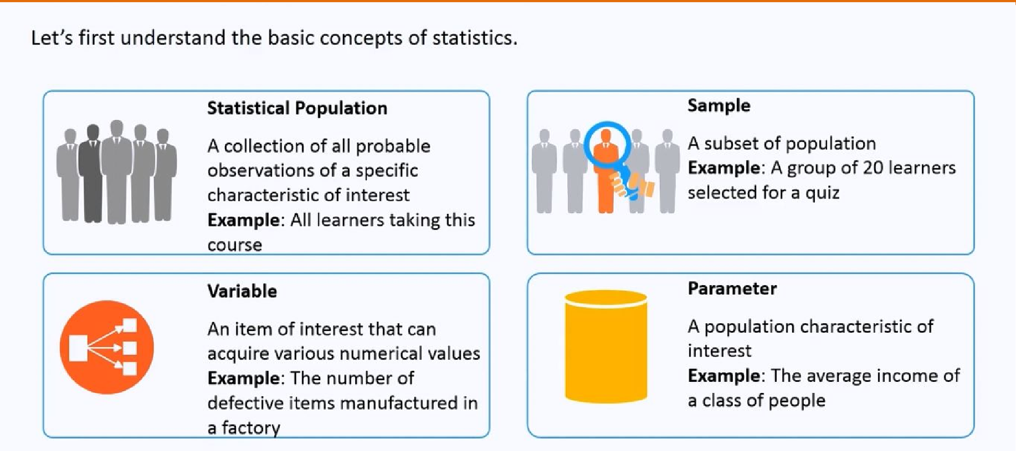
Examples
© 2018 DataMites™. All Rights Reserved | www.datamites.com
STATISTICS ESSENTIALS

Slide 9
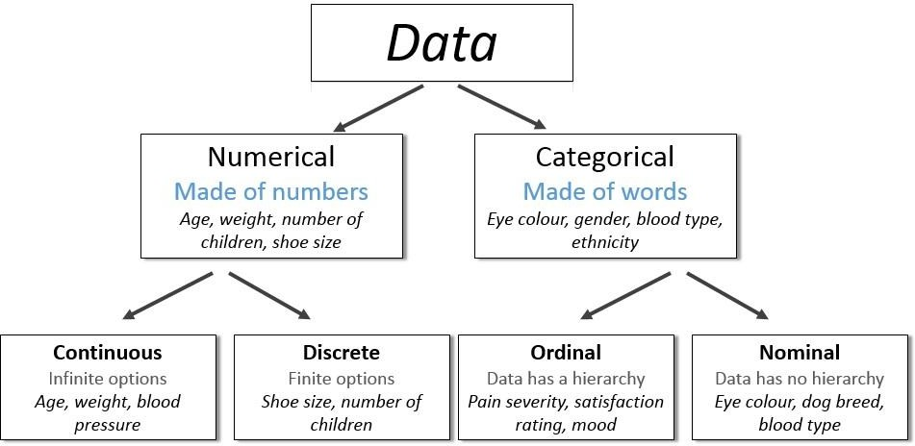
Types of Data
© 2018 DataMites™. All Rights Reserved | www.datamites.com
STATISTICS ESSENTIALS

Slide 10
Examples of variables
Example: Identify each of the following as examples of qualitative or numerical variables:
The temperature in Barrow, Alaska at 12:00 pm on any given day.
The model of automobile.
Whether or not a 6 volt lantern battery is defective.
The weight of a lead pencil.
The length of time billed for a long distance telephone call.
The brand of cereal children eat for breakfast.
The type of book taken out of the library by an adult.
© 2018 DataMites™. All Rights Reserved | www.datamites.com
STATISTICS ESSENTIALS

Slide 11
Examples of variables…
Example: Identify each of the following as examples of
nominal, (2) ordinal, (3) discrete, or (4) continuous variables:
The length of time until a pain reliever begins to work.
The number of chocolate chips in a cookie.
The number of colors used in a statistics textbook.
The brand of refrigerator in a home.
The overall satisfaction rating of a new car.
The number of files on a computer’s hard disk.
The pH level of the water in a swimming pool.
The number of staples in a stapler.
© 2018 DataMites™. All Rights Reserved | www.datamites.com
STATISTICS ESSENTIALS

Slide 12
Harnessing Data
Module - 2
1
© 2018 DataMites™. All Rights Reserved | www.datamites.com
STATISTICS ESSENTIALS

Slide 13
Steps Involved In Descriptive Statistics
Collecting the data
Presenting the data-->Visualization using Matplotlib and Seaborn.
Summarizing the data-->Module 3
© 2018 DataMites™. All Rights Reserved | www.datamites.com
STATISTICS ESSENTIALS

Slide 14
Making sense of the data
A sample which is drawn from the population should have same characteristics as the population.
Sampling can be:
with replacement: a member of the population may be chosen more than once
without replacement: a member of the population may be chosen only once (lottery ticket)
© 2018 DataMites™. All Rights Reserved | www.datamites.com
STATISTICS ESSENTIALS

Slide 15
Collecting The Data
Step1:-Define the object or aim of the experiment.
i.e Estimate the average life of electronic component
Step2:-Define the variable and population of interest.
i.e usage,power rating,battery life etc
Step3:-Defining the data collection scheme and data measuring scheme.
i.e sampling procedure,sample size,data measuring device.
Step4:-Defining the appropriate descriptive and inferential analysis techniques
© 2018 DataMites™. All Rights Reserved | www.datamites.com
STATISTICS ESSENTIALS

Slide 16
Methods Used To Collect Data
Experiment: The investigator controls or modifies the environment and observes the effect on the variable under study.
Survey: Data are obtained by sampling some of the population of interest. The investigator does not modify the environment.
Census: A 100% survey. Every element of the population is listed. Seldom used: difficult and time-consuming to compile, and expensive.
Judgment Samples: It is a non-probability sampling technique in which the sample members are chosen only on the basis of the researcher's knowledge and judgment.
Probability Samples: Samples in which the elements to be selected are drawn on the basis of probability. Each element in a population has a certain probability of being selected as part of the sample.
© 2018 DataMites™. All Rights Reserved | www.datamites.com
STATISTICS ESSENTIALS

Slide 17
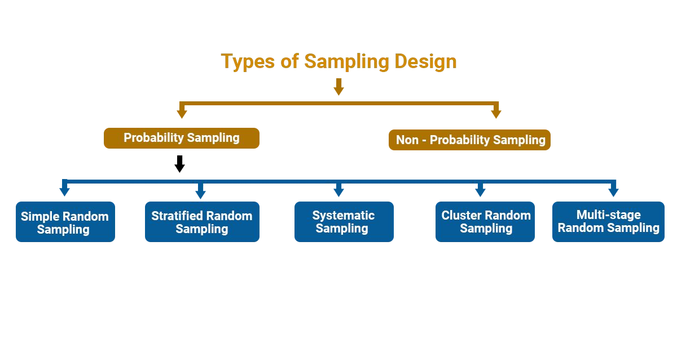
Types Of Sampling
© 2018 DataMites™. All Rights Reserved | www.datamites.com
STATISTICS FOR DATA SCIENCE

Slide 18
Probability Sampling
Simple Random sampling :-each sample of the same size has an equal chance of being selected.
Stratified Sampling :-divide the population into groups called strata and then take a sample from each stratum.
Cluster sampling :-divide the population into strata and then randomly select some of the strata. All the members from these strata are in the cluster sample.
Systematic sampling :-randomly select a starting point and take every n-th piece of data from a listing of the population.
Multistage Random :- divide the population into clusters and select some clusters at the first stage. At each subsequent stage, you further divide up those selected clusters into smaller clusters, and repeat the process until you get the desired sample size.
© 2018 DataMites™. All Rights Reserved | www.datamites.com
STATISTICS ESSENTIALS

Slide 19
Sampling Example
Example: An employer is interested in the time it takes each employee to commute to work each morning. A random sample of 35 employees will be selected and their commuting time will be recorded.
There are 2712 employees.
Each employee is numbered: 0001, 0002, 0003, etc. up to 2712.
Using four-digit random numbers, a sample is identified: 1315, 0987, 1125, etc.
© 2018 DataMites™. All Rights Reserved | www.datamites.com
STATISTICS ESSENTIALS

Slide 20
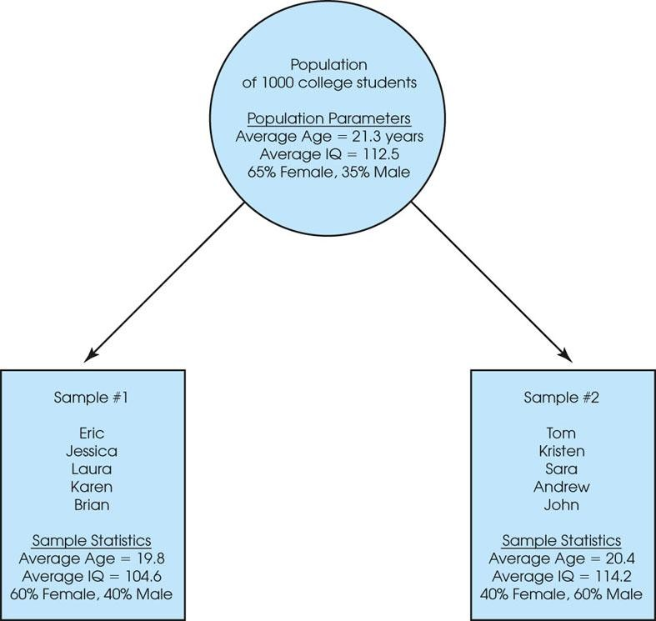
Sampling Error
The discrepancy between a sample statistic and its population parameter is called sampling error.
Defining and measuring sampling error is a large part of inferential statistics
Figure 1.2
A demonstration of sampling error. Two samples are selected from the same population. Notice that the sample statistics are different from one sample to another, and all of the sample statistics are different from the corresponding population parameters. The natural differences that exist, by chance, between a sample statistic and a population parameter are called sampling error.
© 2018 DataMites™. All Rights Reserved | www.datamites.com
STATISTICS ESSENTIALS

Slide 21
Exploratory Analysis
Module - 3
2
© 2018 DataMites™. All Rights Reserved | www.datamites.com
STATISTICS ESSENTIALS

Slide 22
Measures of Central Tendencies
© 2018 DataMites™. All Rights Reserved | www.datamites.com
24

Slide 23
Central Tendency
The property of data being concentrated in the centre.
© 2018 DataMites™. All Rights Reserved | www.datamites.com
23

Slide 24
Measures of Central Tendency
Mean
Median
Mode
© 2018 DataMites™. All Rights Reserved | www.datamites.com
STATISTICS ESSENTIALS
24

Slide 25
Mean
The mean is the average of all numbers and is sometimes called the arithmetic mean.
© 2018 DataMites™. All Rights Reserved | www.datamites.com

Slide 26
Median
The statistical median is the middle number in a sequence of numbers. To find the median, organize each number in order by size; the number in the middle is the median
© 2018 DataMites™. All Rights Reserved | www.datamites.com

Slide 27
Mode
The mode is the number that occurs most often within a set of numbers.
© 2018 DataMites™. All Rights Reserved | www.datamites.com

Slide 28
Measure of Spread / Data Variability
2
© 2018 DataMites™. All Rights Reserved | www.datamites.com

Slide 29
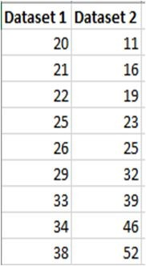
Range
The range is the difference between the highest and lowest values within a set of numbers.
© 2018 DataMites™. All Rights Reserved | www.datamites.com

Slide 30
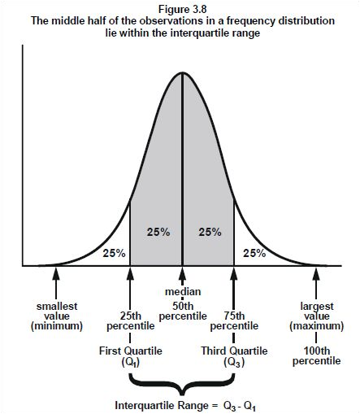
Interquartile Range (IQR)Range
The interquartile range is the middle half of the data.
Mathematically the interquartile range includes the 50% of data points that fall between Q1 and Q3.
© 2018 DataMites™. All Rights Reserved | www.datamites.com

Slide 31
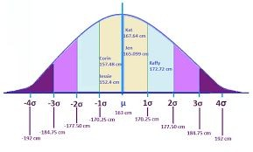
Standard Deviation (σ)
Standard Deviation (SD) is a measure that is used to quantify the amount of variation or dispersion of a set of data values.
© 2018 DataMites™. All Rights Reserved | www.datamites.com

Slide 32
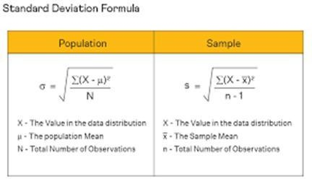

Standard Deviation (σ)
© 2018 DataMites™. All Rights Reserved | www.datamites.com
STATISTICS ESSENTIALS

Slide 33
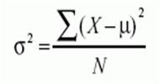

Variance(σ²)
Variance is the average squared difference of the values from the mean. Unlike the previous measures of variability, the variance includes all values in the calculation by comparing each value to the mean.
© 2018 DataMites™. All Rights Reserved | www.datamites.com

Slide 34
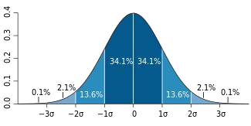
Percentile
A percentile (or a centile) is a measure used in statistics indicating the value below which a given percentage of observations in a group of observations fall.
© 2018 DataMites™. All Rights Reserved | www.datamites.com
STATISTICS ESSENTIALS

Slide 35
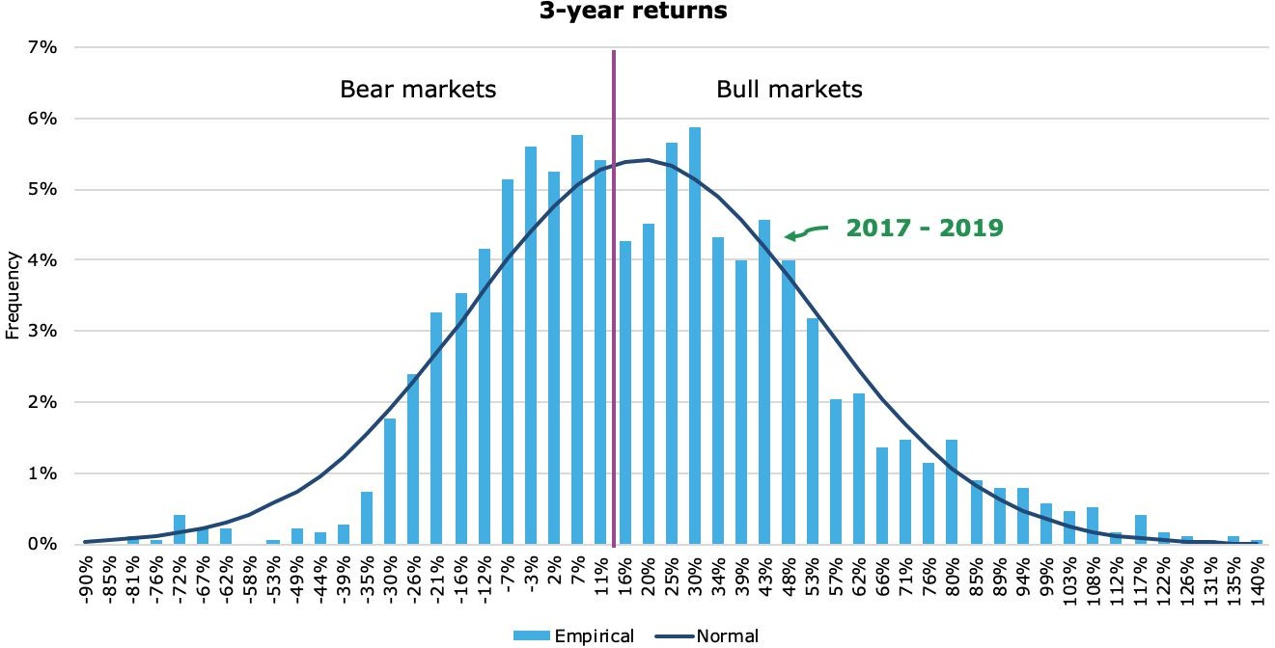
Distributions
The graphical representation of all observations is known as distribution
© 2018 DataMites™. All Rights Reserved | www.datamites.com

Slide 36
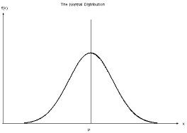
Normal Distribution
Normal distribution, also known as the Gaussian distribution, is a probability distribution that is symmetric about the mean, showing that data near the mean are more frequent in occurrence than data far from the mean.
© 2018 DataMites™. All Rights Reserved | www.datamites.com

Slide 37
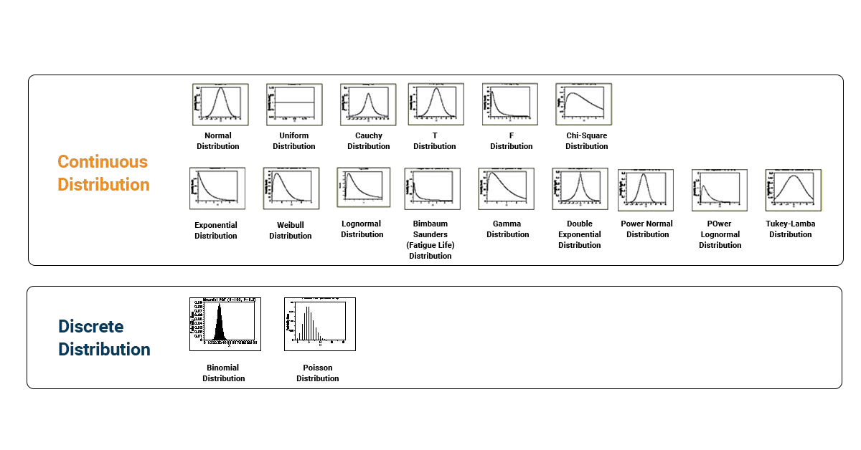
Types Of Distributions
© 2018 DataMites™. All Rights Reserved | www.datamites.com
STATISTICS ESSENTIALS

Slide 38
Properties Of Normal Distribution
Empirical Rule
Distortion in Normal Distribution
Central Limit Theorem
Standard Normal Distribution
Outliers
QQ plot
Log,Sqrt,Boxcox transformation
© 2018 DataMites™. All Rights Reserved | www.datamites.com

Slide 39
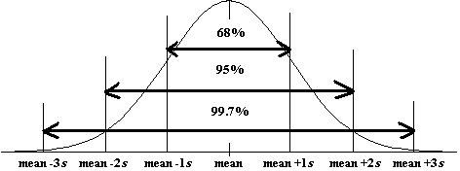
Empirical Rule
The empirical rule states that for a normal distribution, nearly all of the data will fall within three standard deviations of the mean. The empirical rule can be broken down into three parts:
68% of data falls within the first standard deviation from t
95% fall within two standard deviations. (2 Sigma)
99.7% fall within three standard deviations. (3 Sigma)
Any points lying after 3 sigma is outliers.
he mean. (1 Sigma)
© 2018 DataMites™. All Rights Reserved | www.datamites.com

Slide 40
Distortion in Normal Distribution
The distortion in normally distributed curves can be quantified in 2 ways
Skewness
Kurtosis
© 2018 DataMites™. All Rights Reserved | www.datamites.com

Slide 41
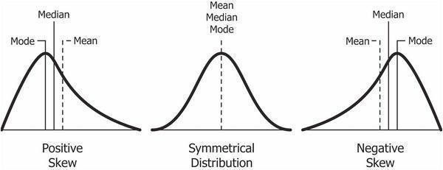
Skewness in Normal Distribution
Skewness is asymmetry in a statistical distribution, in which the curve appears distorted or skewed either to the left or to the right.
Skewness can be quantified to define the extent to which a distribution differs from a normal distribution
If the skewness is greater than 1 or less than -1, the data is highly skewed.
© 2018 DataMites™. All Rights Reserved | www.datamites.com

Slide 42
How much Skewness and Kurtosis
If the skewness is between -0.5 and 0.5, the data are fairly symmetrical. If the skewness is between -1 and – 0.5 or between 0.5 and 1, the data is moderately skewed.
If the skewness is greater than 1or less than -1, the data is highly skewed.
A standard normal distribution has kurtosis of 3 and is recognized as mesokurtic. An increased kurtosis (>3) can be visualized as a thin “bell” with a high peak whereas a decreased kurtosis corresponds to a broadening of the peak and “thickening” of the tails.
© 2018 DataMites™. All Rights Reserved | www.datamites.com

Slide 43
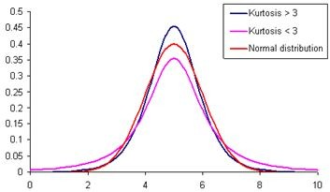
Kurtosis in Normal Distribution
In probability theory and statistics, kurtosis is a measure of the “peakedness" of the probability distribution of a
real-valued random variable.
© 2018 DataMites™. All Rights Reserved | www.datamites.com

Slide 44
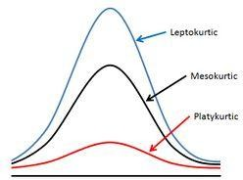
4
© 2018 DataMites™. All Rights Reserved | www.datamites.com

Slide 45
Which is Best—the Mean, Median, or Mode?
When you have a symmetrical distribution for continuous data, the mean, median, and mode are equal. In this case, analysts tend to use the mean because it includes all of the data in the calculations. However, if you have a skewed distribution, the median is often the best measure of central tendency.
When you have categorical or discrete data, the median or mode is usually the best choice. For categorical data, you have to use the mode.
© 2018 DataMites™. All Rights Reserved | www.datamites.com

Slide 46
Correcting Distortion in Normal Distribution
Transformation is nothing but taking a mathematical function and applying it to the data.
Log Transformation [Each data point is replaced with log(x) to obtain ND]
Square-Root Transformation [Each data point is replaced by its square root] Reciprocal Transformation [ It takes the inverse of x ie., 1/x]
Box-Cox Transformation [Transformation of non-normal dependent variables to normal shape]
Reason: To transform the data to either reduce the skewness or to normalize the data or simply make the data easier to understand.
© 2018 DataMites™. All Rights Reserved | www.datamites.com

Slide 47
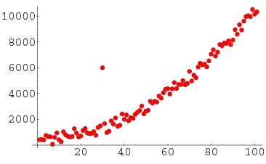
Outliers
An outlier is an observation point that is distant from other observations. An outlier may be due to variability in the measurement or it may indicate experimental error; the latter are sometimes excluded from the data set.
https://tribe.datamites.com/pos ts/outliers
© 2018 DataMites™. All Rights Reserved | www.datamites.com

Slide 48
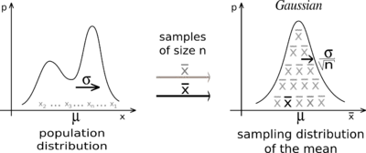
Central Limit Theorem
The central limit theorem states that the distribution of sample means approximates a normal distribution as the sample size gets larger (assuming that all samples are identical in size), regardless of population
distribution shape.
CLT in one sentence "Even if I'm not normal, the average is normal"
When collecting means of the samples from any distribution, the no of samples taken for calculating the mean should be greater or equal to 30.
© 2018 DataMites™. All Rights Reserved | www.datamites.com
STATISTICS FOR DATA SCIENCE
49

Slide 49
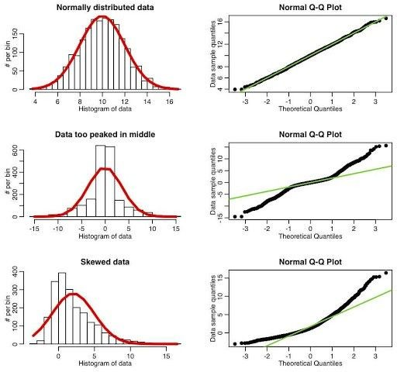
Q-Q Plots
Q-Q plots are used to find the type of distribution for a random variable whether it be a Gaussian Distribution / Normal distribution or not.
© 2018 DataMites™. All Rights Reserved | www.datamites.com
50

Slide 50
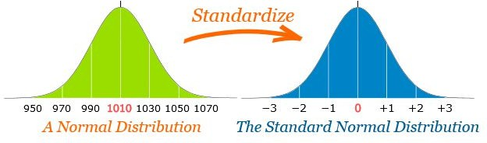
Standard Normal Distribution
The standard normal distribution is a special case of the normal distribution. It is the distribution that occurs when a normal random variable has a mean of zero and a standard deviation of one.
© 2018 DataMites™. All Rights Reserved | www.datamites.com
STATISTICS FOR DATA SCIENCE

Slide 51
Z- Score / Z-Value/ Standard Score
A z-score (aka, a standard score) indicates how many standard deviations an element is above or below from the mean. A
z-score can be calculated from the following formula.
z = (X - μ) / s
© 2018 DataMites™. All Rights Reserved | www.datamites.com
STATISTICS ESSENTIALS

Slide 52
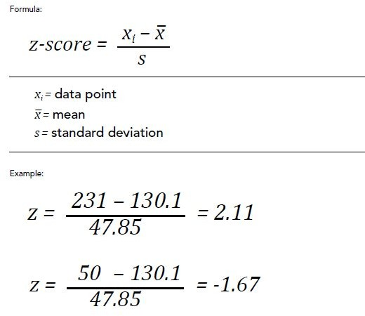
Calculating Z-Score
© 2018 DataMites™. All Rights Reserved | www.datamites.com

Slide 53
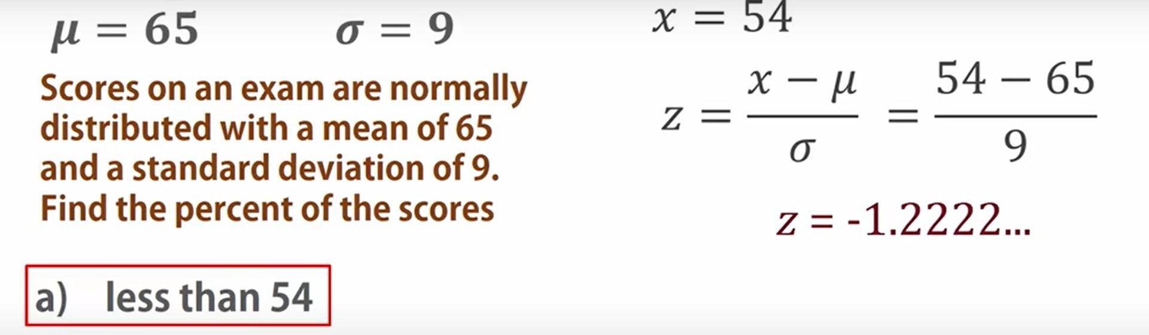
5
© 2018 DataMites™. All Rights Reserved | www.datamites.com

Slide 54
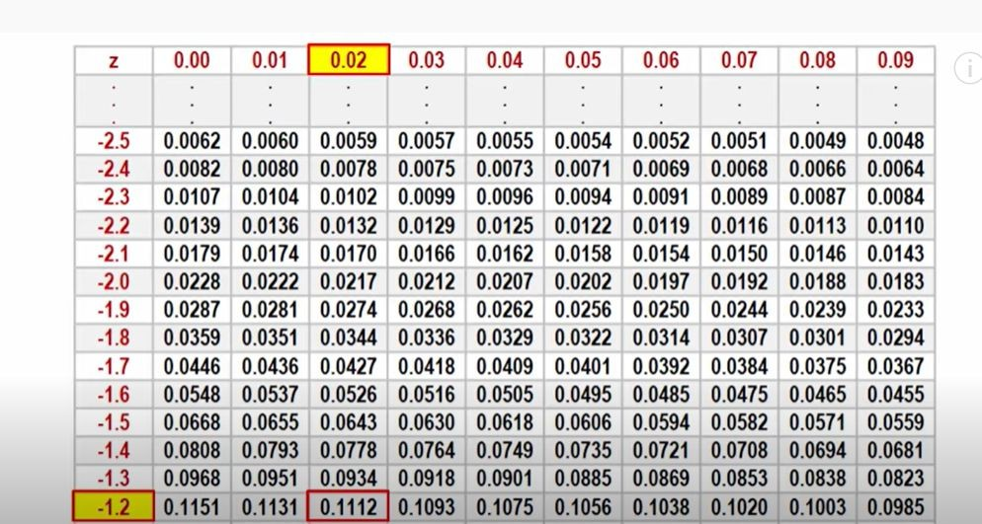
5
© 2018 DataMites™. All Rights Reserved | www.datamites.com

Slide 55
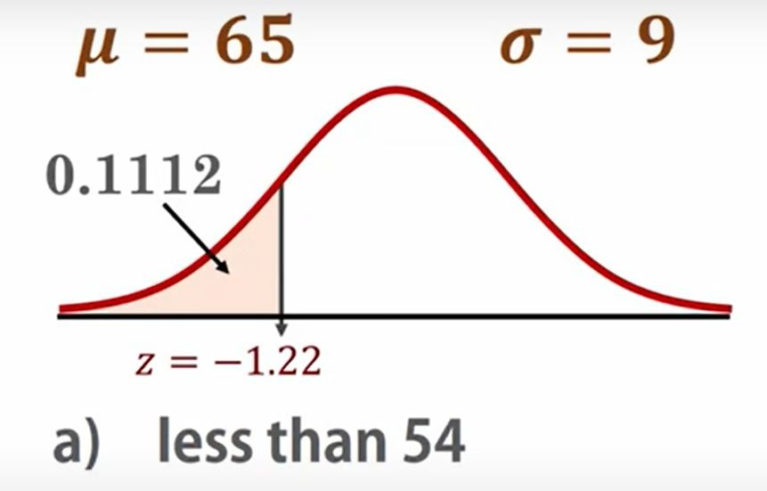
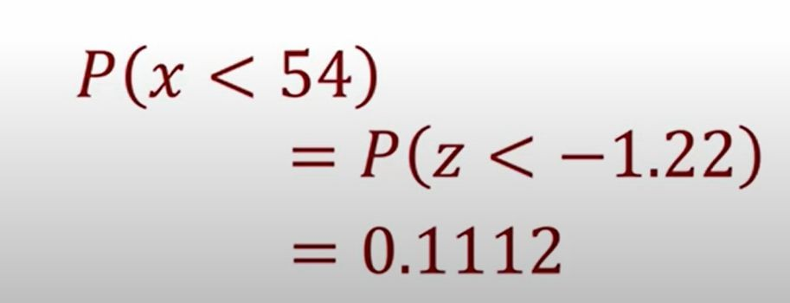
So on this normal curve, for z=-1.22, the area on the left is 0.1112 as we saw in the z-score table. Therefore, the probability that x < 54 is 11.12%.
Z-score is the powerful tool to find the probability of distribution using Z-score table.
5
© 2018 DataMites™. All Rights Reserved | www.datamites.com

Slide 56
Outliers
- Z-scores generally range from -3.0 to +3.0.
- For bell shaped distributions,
•
the empirical rule says 99.7% of all the data values have z-scores between -3.0 and +3.0.
- We consider any z-score that is either less than -3.0 or greater than +3.0 to be an outlier.
•
© 2018 DataMites™. All Rights Reserved | www.datamites.com

Slide 57
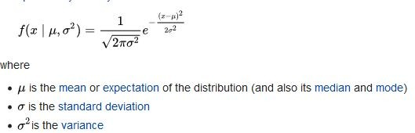
Probability Density Function
Probability density is the relationship between observations and their probability.
The overall shape of the probability density is referred to as a probability distribution, and the calculation of probabilities for specific outcomes of a random variable is performed by a probability density function, or PDF for short.
The probability density function for Normal distribution is given as
CDF: It provides a shortcut for calculating many probabilities at once. We integrate the pdf function to get the cumulative probability.
© 2018 DataMites™. All Rights Reserved | www.datamites.com

Slide 58
Measure of Distance
Euclidean Distance
Manhattan Distance
Minkowski Distance
© 2018 DataMites™. All Rights Reserved | www.datamites.com
STATISTICS ESSENTIALS

Slide 59
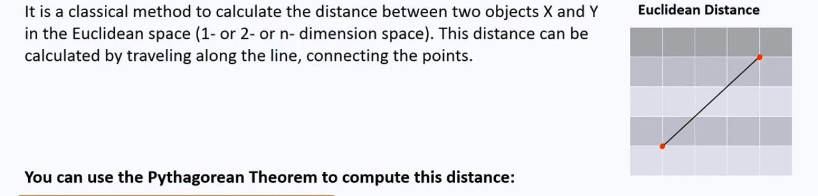

Euclidean Distance
© 2018 DataMites™. All Rights Reserved | www.datamites.com
STATISTICS ESSENTIALS

Slide 60
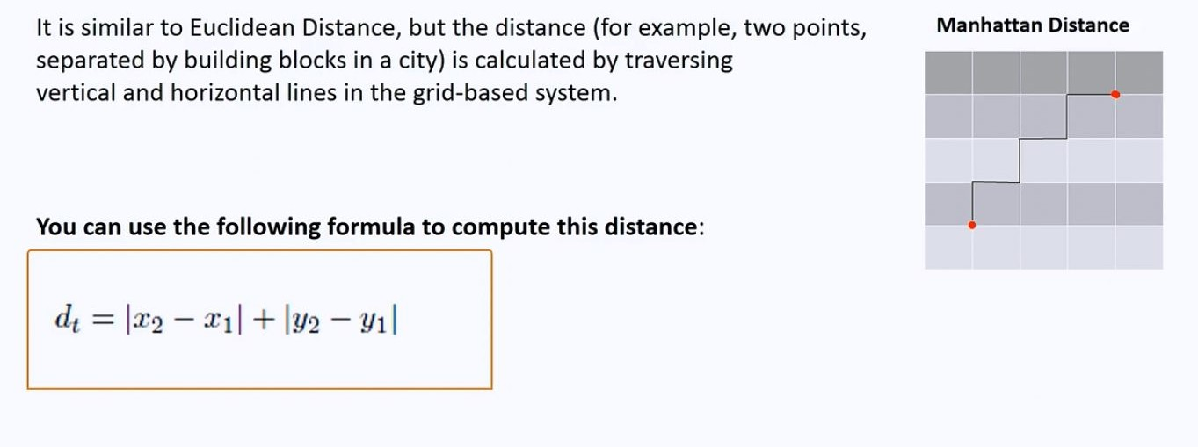
Manhattan Distance
© 2018 DataMites™. All Rights Reserved | www.datamites.com
STATISTICS ESSENTIALS

Slide 61
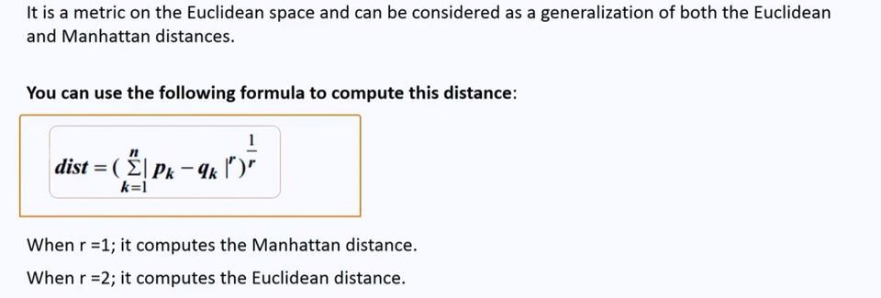
Minkowski Distance
© 2018 DataMites™. All Rights Reserved | www.datamites.com
STATISTICS ESSENTIALS

Slide 62
Use of Distance Metrics
Statistical distances are used for several important reasons:
Outlier Detection
Clustering Analysis
Feature Selection
Data Cleaning
Dimensionality Reduction
© 2018 DataMites™. All Rights Reserved | www.datamites.com

Slide 63
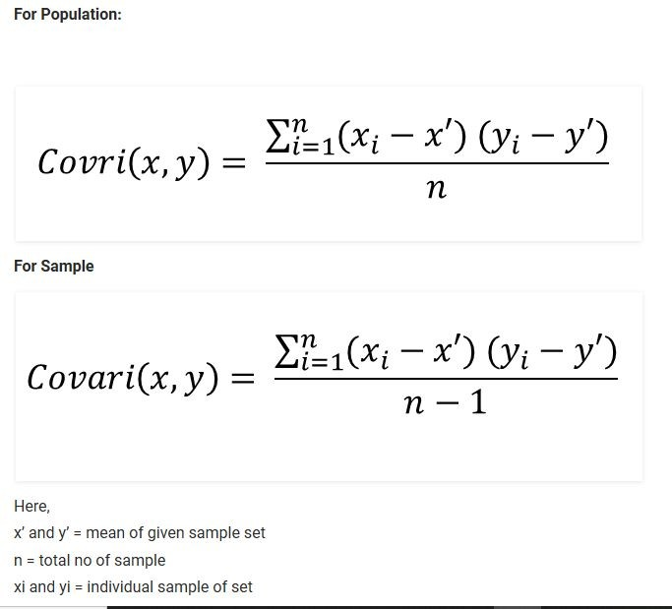
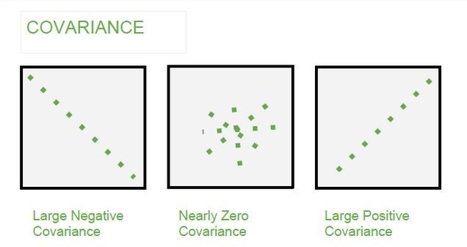
Covariance
It is the relationship between a pair of random variables where change in one variable causes change in another variable.
It can take any value between -∞ to +∞, where the negative value represents the negative
relationship whereas a positive value represents the positive relationship.
© 2018 DataMites™. All Rights Reserved | www.datamites.com
STATISTICS ESSENTIALS

Slide 64
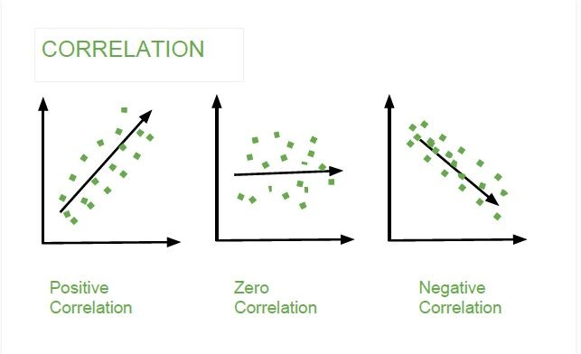
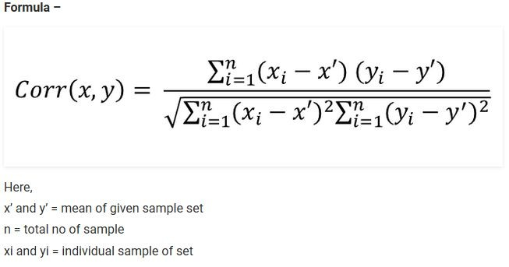
Correlation
It is the scaled version of Covariance.
Correlation is a step ahead of covariance as it quantifies the relationship between two random variables. In simple terms, it is a unit measure of how these variables change concerning each other (normalized covariance value).
© 2018 DataMites™. All Rights Reserved | www.datamites.com
STATISTICS ESSENTIALS

Slide 65
Based on the correlation coefficient, we can select the important features:
If the independent feature is not correlated with the target variable, we could remove that feature.
Or if two independent features are highly correlated, we could remove any one feature.
© 2018 DataMites™. All Rights Reserved | www.datamites.com

Slide 66
Hypothesis Testing &
Other computational Techniques
Module - 4
6
© 2018 DataMites™. All Rights Reserved | www.datamites.com
STATISTICS ESSENTIALS

Slide 67
Hypothesis Testing
Hypothesis is a statement, assumption or claim about the value of the parameter (mean, variance, median etc.).
A hypothesis is an educated guess about something in the world around you. It should be testable, either by experiment or observation.
Ex:-if we make a statement that “Dhoni is the best Indian Captain ever.” This is an assumption that we are making based on the average wins and loses team had under his captaincy. We can test this statement based on all the match data.
© 2018 DataMites™. All Rights Reserved | www.datamites.com
STATISTICS ESSENTIALS

Slide 68
Comparing and Analyzing Relationships
Does the treatment with new drug help more patients than the standard treatment with old drug?
Which of these four methods is the most efficient way of teaching machine learning?
© 2018 DataMites™. All Rights Reserved | www.datamites.com
STATISTICS ESSENTIALS

Slide 69
Types of Hypothesis
When a hypothesis specifies an exact value of parameter, it is simple hypothesis. For eg., A motorcycle company claiming that a certain model gives an average mileage of 100 km per litre, this is a case of simple hypothesis.
If a hypothesis specifies a range of values then it is called a composite hypothesis. For eg., Average age of students in a class is greater than 20. This statement is a composite hypothesis.
© 2018 DataMites™. All Rights Reserved | www.datamites.com
STATISTICS ESSENTIALS

Slide 70
Null Hypothesis (H₀)
The null hypothesis is the hypothesis to be tested for possible rejection under the assumption that it is true.
The concept of the null is similar to innocent until proven guilty.
© 2018 DataMites™. All Rights Reserved | www.datamites.com
STATISTICS ESSENTIALS

Slide 71
Alternate Hypothesis (H_{A})/(H1)
The alternative hypothesis complements the Null hypothesis.
It is opposite of the null hypothesis such that both the alternate and null hypotheses together cover all possible values of the population parameter.
© 2018 DataMites™. All Rights Reserved | www.datamites.com
STATISTICS ESSENTIALS

Slide 72
Hypothesis Testing – Case Discussion
Consider a court of law:
The null hypothesis always begins with the assumption that the defendant is innocent.
We require evidence to reject the null hypothesis (convict the defendant).
When we collect evidence and try to reject null hypothesis, there are 2 errors that could potentially occur: Type 1 or Type 2 error.
© 2018 DataMites™. All Rights Reserved | www.datamites.com
STATISTICS ESSENTIALS

Slide 73
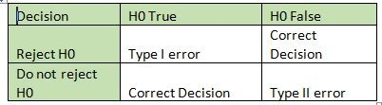
Type I and Type II Error
© 2018 DataMites™. All Rights Reserved | www.datamites.com
STATISTICS ESSENTIALS

Slide 74
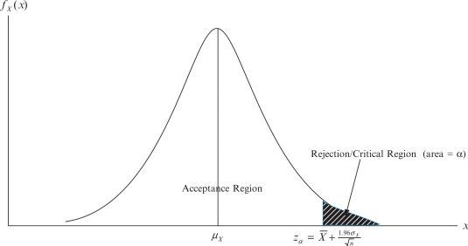
Critical Region
The critical region is that region in the sample space in which if the calculated value lies then we reject the null hypothesis.
The critical region lies in one tail or two tails on the probability distribution curve according to the alternative hypothesis.
The value of critical region is denoted by α.
It is known as level of significance. i.e what is passing criteria of test.
© 2018 DataMites™. All Rights Reserved | www.datamites.com
STATISTICS ESSENTIALS

Slide 75
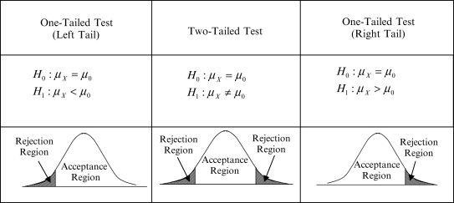
Cases Of Critical Region
If the alternate hypothesis gives the alternate in both directions (less than and greater than) of the value of the parameter specified in null hypothesis, it is called Two-tailed test.
E.g. H0: mean= 100 —-> H1: mean not equal to 100
Here according to H1, mean can be greater than or less than 100. This is an example of Two-tailed test.
If the alternate hypothesis gives the alternate in only one direction (either less than or greater than) of the value of the parameter specified in null hypothesis, it is called One-tailed test.
E.g. H0: mean>=100 —-> H1: mean< 100
Three cases of Critical Region arise.
© 2018 Data
Mites™. All Rights Reserved | www.datamites.com
STATISTICS ESSENTIALS

Slide 76
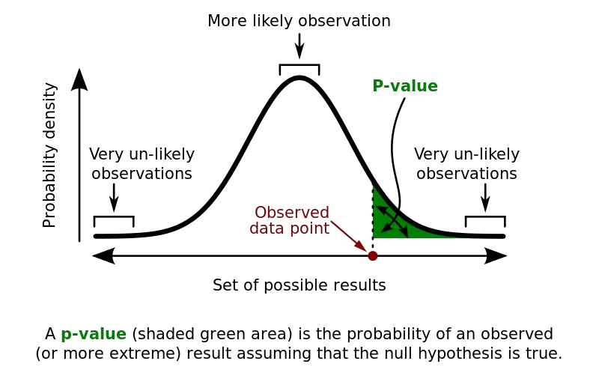
p –Value
Since we know that passing value of a test can be 1% or 5%. But we must also know what are the test score and this test score is known as p- value.
Technically p-value (probability value) is the smallest level of significance at which a null hypothesis can be rejected.
If p-value is greater than alpha, we do not
reject the null hypothesis.
If p-value is smaller than alpha, we reject the null hypothesis.
© 2018 DataMites™. All Rights Reserved | www.datamites.com
STATISTICS ESSENTIALS

Slide 77
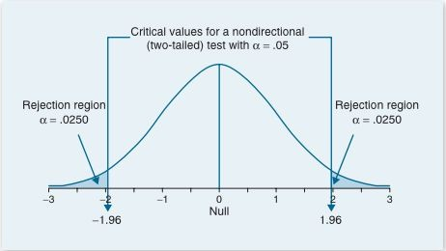
Process of Hypothesis Testing
Set up Null hypothesis and Alternate hypothesis.
Decide the level of
significance (1% or 5%).
Select the test as per requirement.
Calculate the p-value.
If p-value less than level of significance, reject the null hypothesis.
If p-value more than level of
significance, accept the null hypothesis.
© 2018 DataMites™. All Rights Reserved | www.datamites.com
STATISTICS ESSENTIALS
78

Slide 78
Types of Hypothesis Tests
Parametric Tests:-Those test which considers the shape of distribution of sample.
Non – Parametric Tests:-Those test which do not considers the shape of distribution of sample.
© 2018 DataMites™. All Rights Reserved | www.datamites.com
STATISTICS ESSENTIALS

Slide 79
Applications of Hypothesis Testing
Feature Selection
Model Evaluation & Selection
Hyper Parameter Tuning
Anomaly Detection
© 2018 DataMites™. All Rights Reserved | www.datamites.com
STATISTICS ESSENTIALS

Slide 80
Hypothesis Tests:-Parametric
Z test
T/Student’s T test
Paired t Test
One Way ANOVA
© 2018 DataMites™. All Rights Reserved | www.datamites.com
STATISTICS ESSENTIALS

Slide 81
Hypothesis Tests:-Non Parametric
Chi Square Test
Mann-Whitney Test
Wilcoxon Signed-Rank Test
Kruskal-Wallis Test
Friedman’s ANOVA
© 2018 DataMites™. All Rights Reserved | www.datamites.com
STATISTICS ESSENTIALS

Slide 82
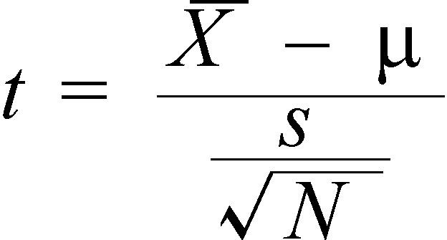
T-test
A t-test is an analysis of two populations means through the use of statistical examination; a t-test with two samples is commonly used with small sample sizes, testing the difference between the samples when the variances of two normal distributions are not known.
This helps in finding the association between Categorical and Continuous features.
X -> Mean of sample set μ -> Mean of Population
S -> Standard deviation of sample N -> Sample size
© 2018 DataMites™. All Rights Reserved | www.datamites.com
STATISTICS ESSENTIALS

Slide 83
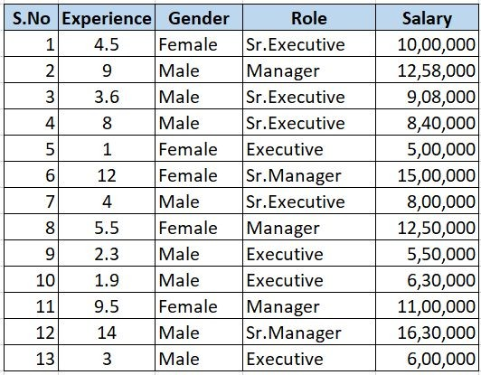
T-test
© 2018 Data
Mites™. All Rights Reserved | www.datamites.com
STATISTICS ESSENTIALS

Slide 84
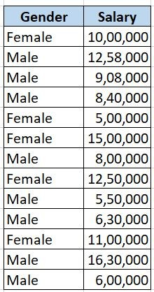
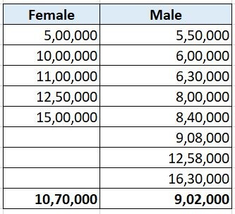

T-test
The T-Test helps to determine whether there is a statistically significant difference in the average salaries between these two groups.
H0: There is no significant difference between two groups.
Female Group:
Mean=10,70,000 SD=3,95,995.81
Male Group:
Mean=9,02,000 SD=7,52,807.45
T-Statistics = 4.24
P-Value = 0.001 (From T-Table)
There is a significant difference in salaries between the two groups.
© 2018 Data
Mites™. All Rights Reserved | www.datamites.com
STATISTICS ESSENTIALS

Slide 85

Paired T-test
The paired t-test is performed when the samples typically consist of matched pairs of similar units, or when there are cases of repeated measures.
For example, there may be instances of the same patients being tested repeatedly—before and after receiving a particular treatment. In such cases, each patient is being used as a control sample against themselves.
© 2018 DataMites™. All Rights Reserved | www.datamites.com
STATISTICS ESSENTIALS

Slide 86
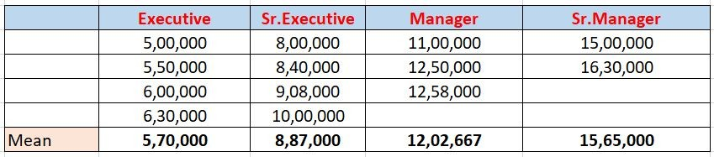
One-Way ANOVA
The one-way analysis of variance (ANOVA) is used to determine whether there are any statistically significant differences between the means of three or more independent (unrelated) groups. Eg.,
Within Group Variance - Values within the group are close to each other Between Group Variance - Values between groups are not close to each other
© 2018 DataMites™. All Rights Reserved | www.datamites.com
STATISTICS ESSENTIALS

Slide 87
One-Way ANOVA
If the within-group variation is less and
between-group variation is high, then it means this feature impacts the target variable. Hence it is an important feature.
© 2018 Data
Mites™. All Rights Reserved | www.datamites.com
STATISTICS ESSENTIALS

Slide 88
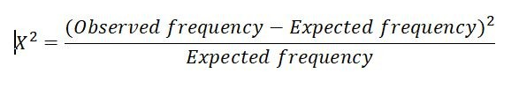
Chi-Square Test
Chi-square test is used for categorical features in a dataset. We calculate Chi-square between each feature and the target and select the desired number of features with best Chi-square scores. It determines if the association between two categorical variables of the sample would reflect their real association in the population. Chi- square score is given by
Observed frequency = No. of observations of class
Expected frequency = No. of expected observations of class if there was no relationship between the feature and the target. Expected Frequency = (Row Total * Column Total)/N
© 2018 DataMites™. All Rights Reserved | www.datamites.com
STATISTICS ESSENTIALS

Slide 89
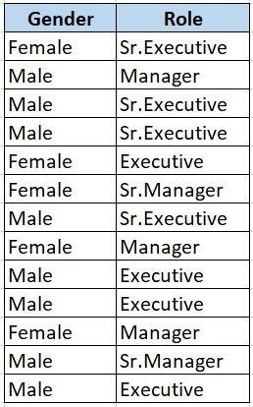

Contingency Table:
The chi-squared value for the given contingency table is 0.257 Significance level is 0.05
The observed p-value is 0.967902
Since p-value > 0.05, we accept the Null hypothesis.
© 2018 DataMites™. All Rights Reserved | www.datamites.com
STATISTICS ESSENTIALS

Slide 90

Thank You.
9
© 2018 DataMites™. All Rights Reserved | www.datamites.com

